Slide 1
GOES-16 Aerosol Detection, Land Surface Temperature in AWIPS-2
NWS/OBS Update to Provisional PS-PVR
March 19, 2018

Slide 2
GOES-16 LST and Aerosol Detection (ADP) in AWIPS-2
NWS transmission via SBN commenced on May 31, 2017
PDA subscriptions to Full Disk, CONUS, Mesoscale sectors for LST, ADP
Fielded AWIPS-2 systems currently ingest and display LST and ADP products
Applies quality flag (DQF) 0 to retain good quality LST
For ADP, NESDIS/STAR added sun glint and angle mask into DQF bits
AWIPS uses DQFs 0, 16, 48 for Low, Med, High Confidence Dust
AWIPS uses DQFs 0, 4, 12 to retain Low, Med, High Confidence Smoke
Sample AWIPS2/CAVE screenshots are in the following slides

Slide 3
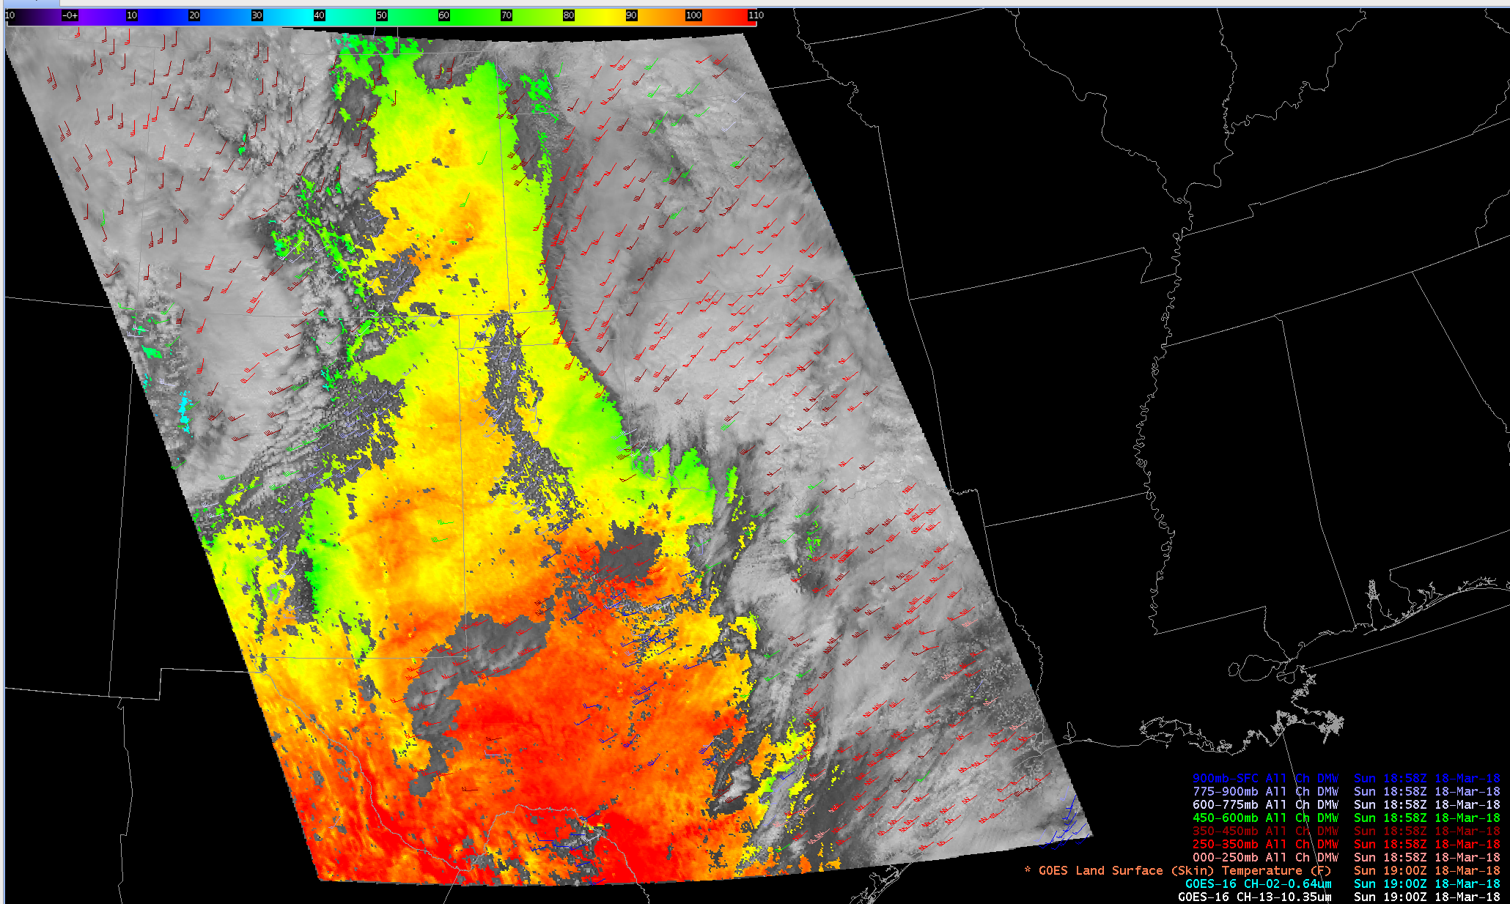
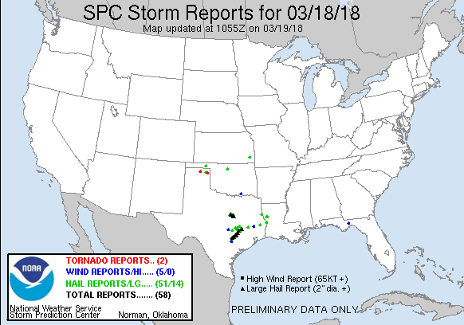
GOES-16 LST with CH-02 Imagery and DMWs (1)
Mesoscale LST
(shaded, DegF)
Sun 18:58Z
18 Mar 2018

Slide 4
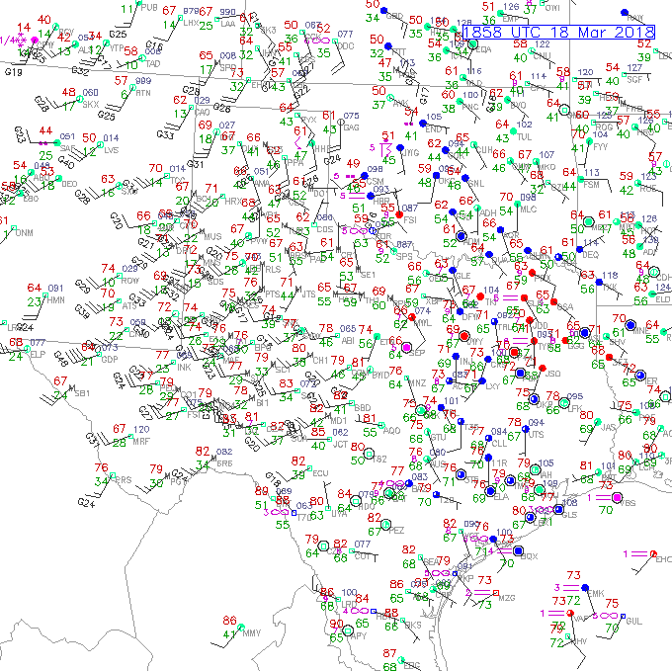
GOES-16 LST with CH-02 Imagery and DMWs (2)
Mesoscale LST
(shaded, DegF)
Sun 18:58Z
18 Mar 2018

Slide 5
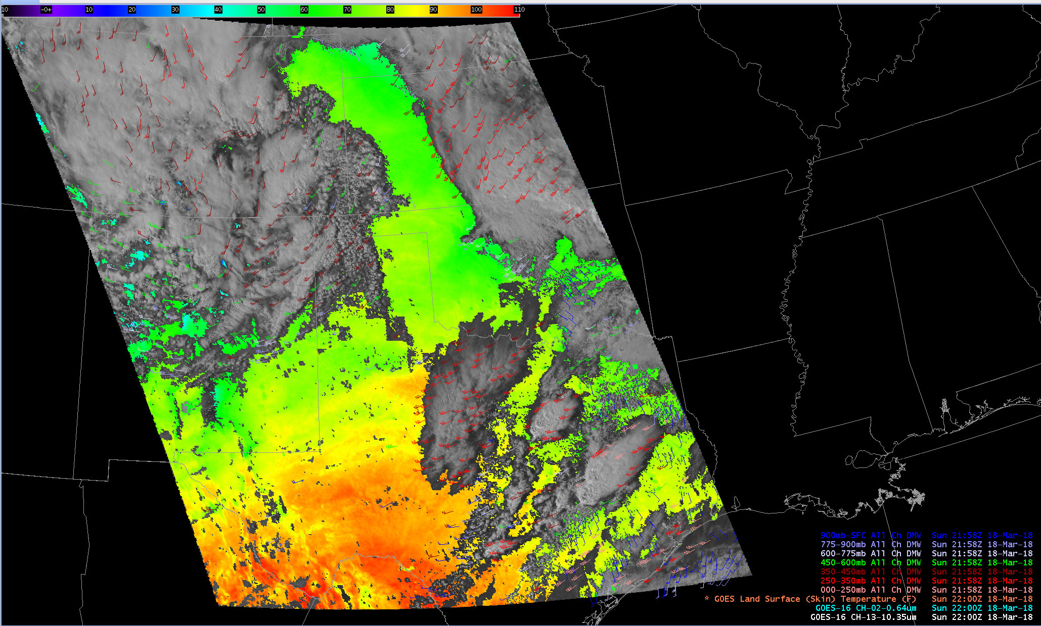
GOES-16 LST with CH-02 Imagery and DMWs (3)
Mesoscale LST
(shaded, DegF)
Sun 21:58Z
18 Mar 2018

Slide 6
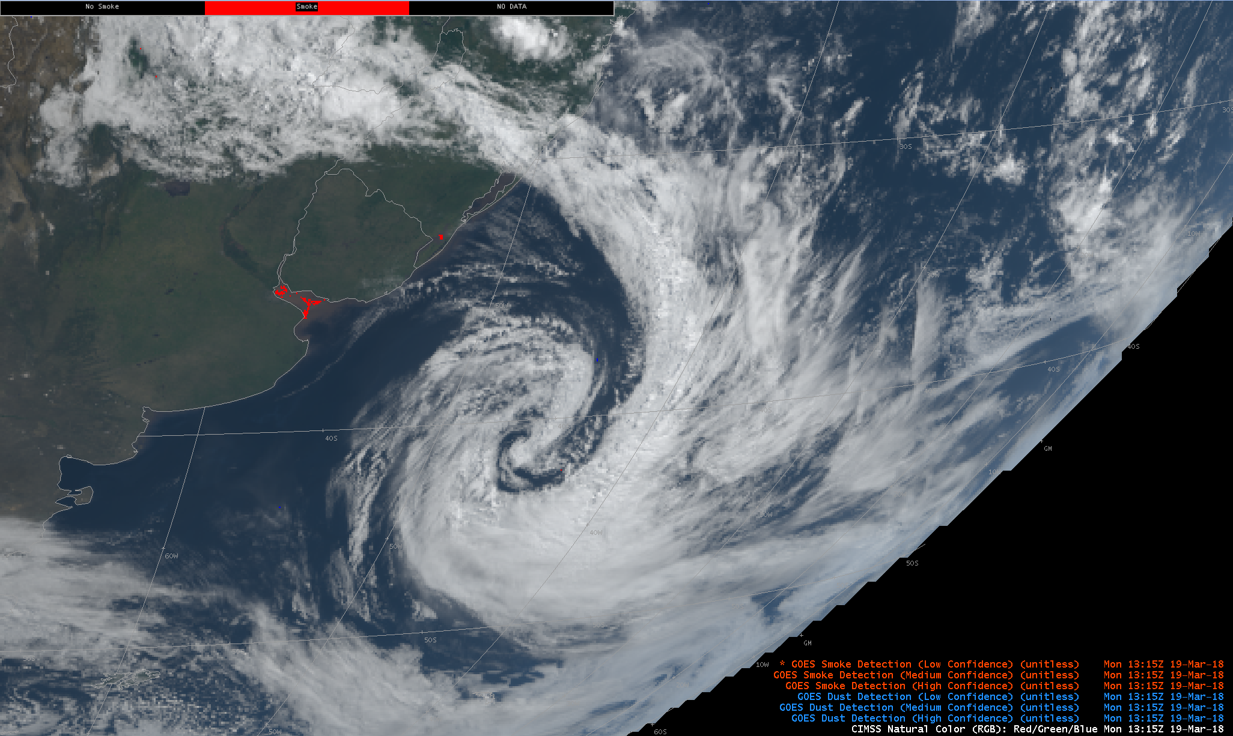
GOES-16 ADP (Smoke)
GOES-16 Smoke and Dust Product
Mon 13:15Z 19 Mar 2018
(Buenos Aires and East Coast of South America)

Slide 7
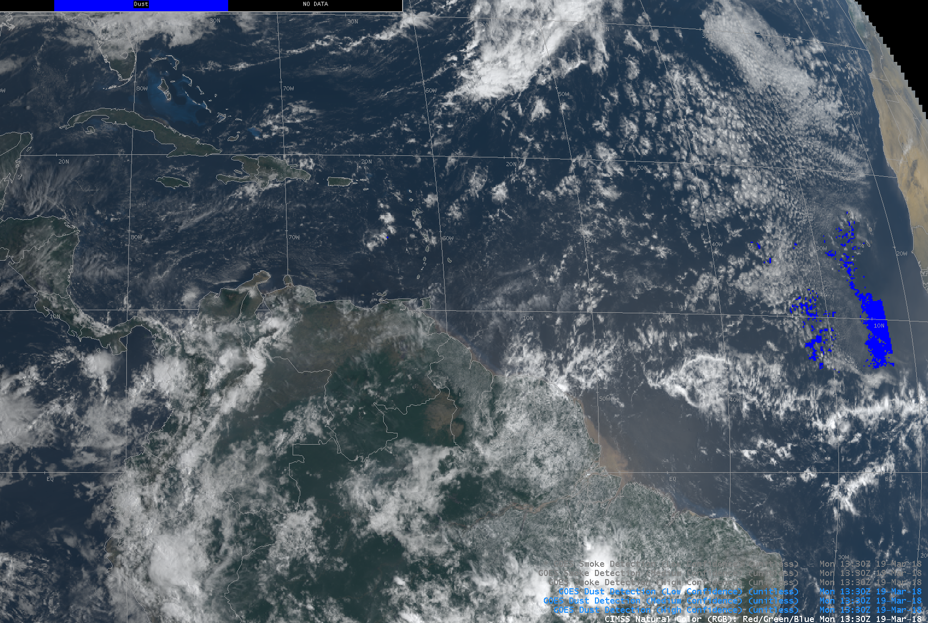
GOES-16 ADP (Dust)
GOES-16 Dust Product
Mon 13:30Z 19 Mar 2018

Slide 8
Questions?

